Slide 1

Infrared alert system with radio frequency capability
T09-Signal senderS
Max Cope
Leslie Eide
Chris Klupenger
SignalSenders

Slide 2
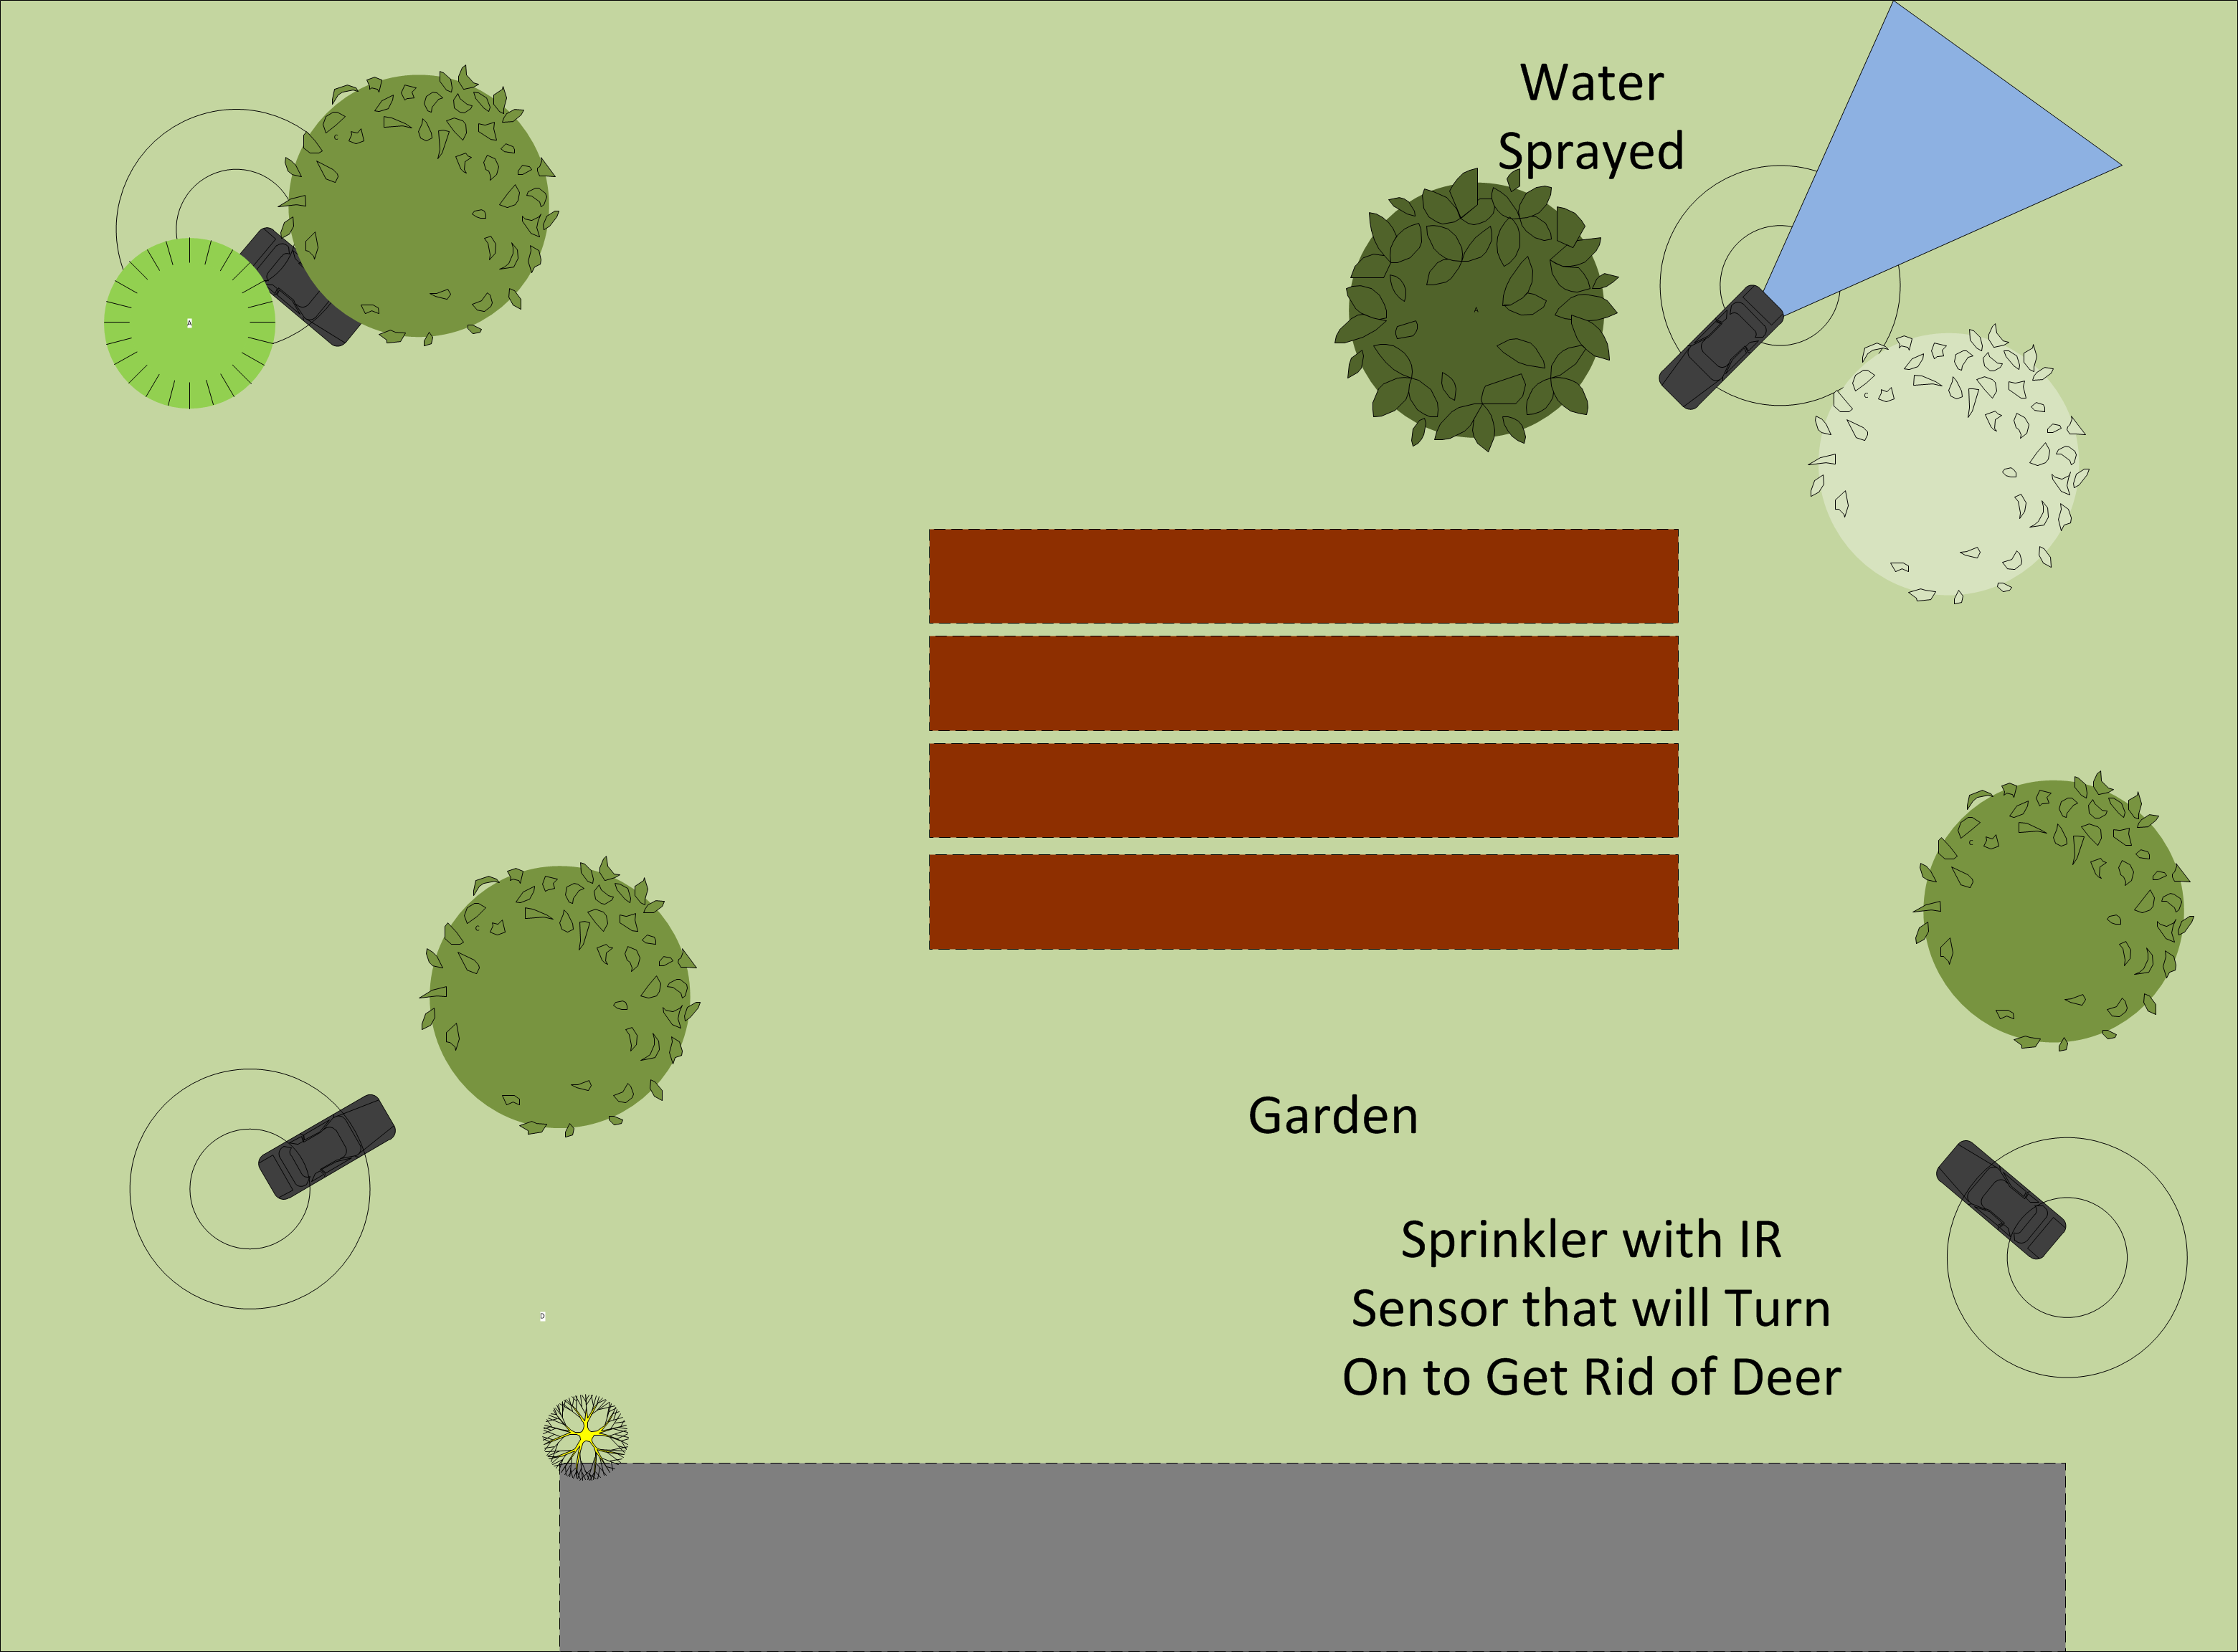
Problem
Practicum Project Guidelines
Motivation
Originally got idea from sprinklers designed to keep deer out of yards
Interests in Radio signals
Battery operation for range extension
Original concepts included mechanical aspects for actuation
SignalSenders

Slide 3
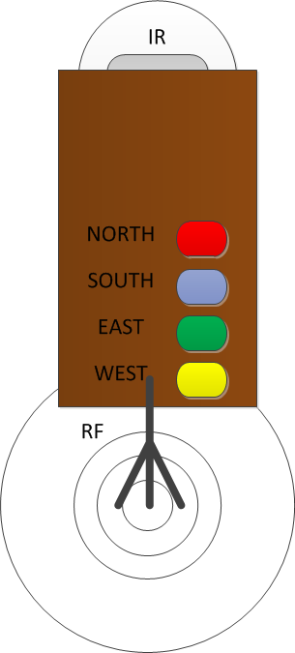
Objective
Develop four working prototypes that can communicate with each other when they sense motion.
Utilize communication within the 2.4GHz ISM band to lessen complexity
Rely on battery power to reduce bulk and understand current dissipation vs voltage
SignalSenders

Slide 4
Alternatives
Wired UNITS
Signal Options
Inefficient at larger ranges
Cables everywhere
WIFI
Bluetooth
RF Signals
IR Signal
SignalSenders

Slide 5
Requirements
Motion Sensor
microcontroller
Signal
Used to sense motion within a specified range
Signal used to send specified signal to microcontroller for further processing
Central to the operation of this system
Takes signal from IR and tells the RF module to send a signal that it detected motion
Takes signal from RF module that another unit sensed motion and light up the corresponding LED associated with the unit ID
In standby listening for a signal from the other units to send to the microcontroller
When prompted from the Microcontroller a signal with unit ID is transmitted to the other units
SignalSenders

Slide 6
Approach
Interaction View
Activity View
SignalSenders

Slide 7
Design
Selection of motion detection
Selection of Microcontroller
Selection of communication
Selection of Actuator
Selection of battery power
Design of schematic
Design of PCB
Housing
SignalSenders

Slide 8
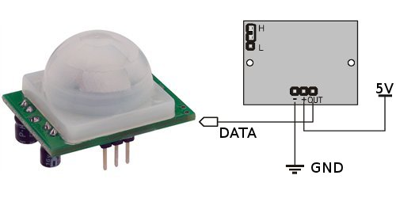
Infrared motion sensor Design
Range
Output of Signal
SignalSenders

Slide 9
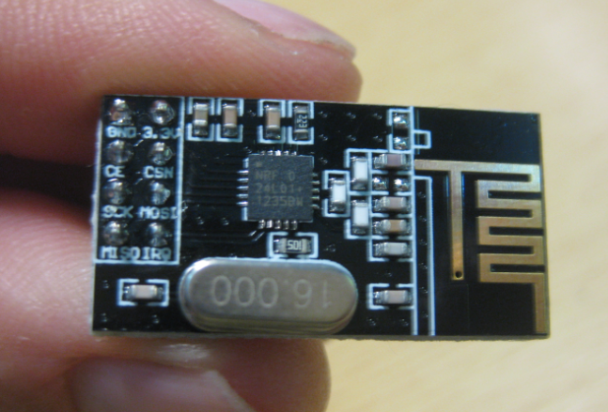
Radio frequency Communication
2.4 GHz ISM Band
Worldwide license-free
GFSK modulation
Communication Pipes
SPI interfacing with uC
SignalSenders

Slide 10
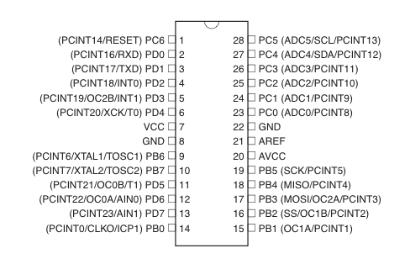
Microcontroller Programming
ATMEGA 328P
Programming
IR Detect
RF SPI
Four LED
SignalSenders

Slide 11
LED Output
Layout of board/housing
SignalSenders

Slide 12
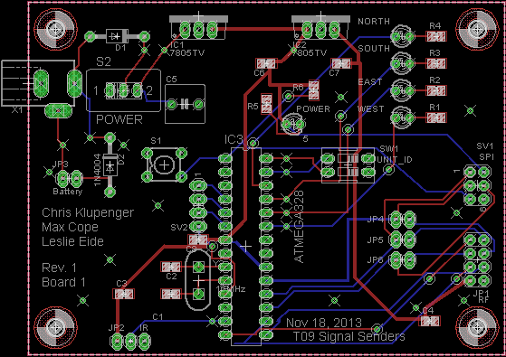
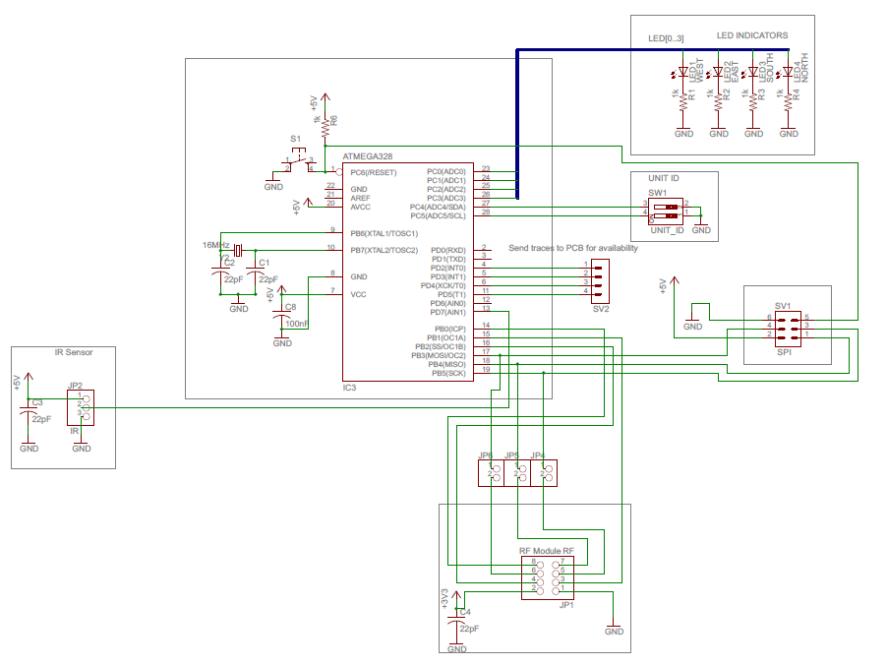
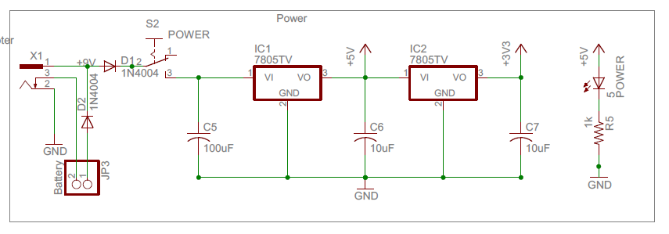
Implementation Schematic/PCB

Slide 13
Intellectual property prior work
RF Modules online
Open source Arduino coding
Nothing proprietary
No schematics followed
SignalSenders

Slide 14
Testing
Strategy
Execution
Testing power
Continuity
Layering complexity
Talk about issues/lack there of
SignalSenders

Slide 15
Results
4 working units (video potential?)
SignalSenders

Slide 16
Contributions
Max cope
Leslie Eide
Chris Klupenger
RF signals
RF Firmware
IR motion detector
LED output panel
Microcontroller
Programming
SignalSenders

Slide 17
Lessons Learned
SignalSenders

